Slide 1

Predict New York City Taxi Demand
Capstone Project Big 4 Team 17/09/2016

Slide 2




Big 4 Team
Shuo Zhang
Bin Fang
Jingyu Zhang
Yunrou Gong
PHD Chemical Engineering
PHD Electrical Engineering
Master Operational Research
PHD GIS

Slide 3
Content
Introduction
Data Pre-processing
Modeling Workflow
Exploratory Data Analysis
Modelling
Ensemble
Prediction
Future Work

Slide 4
Introduction

Slide 5
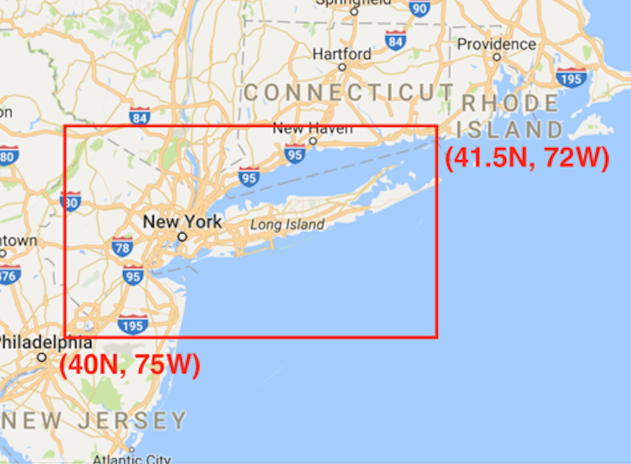
Data Preparation
Raw
Data
~14G
Yellow
12.5G
Green
1.2G
Uber
0.22 G
Weather
0.001G
Feature selection
~1billion
Data Cleaning
Lon,lat-->zipcode
Geocoding
120,000
Dimension reduction
~1 billion
Aggregation
~ 60,000
Data Sets
~ 71,000*5

Slide 6
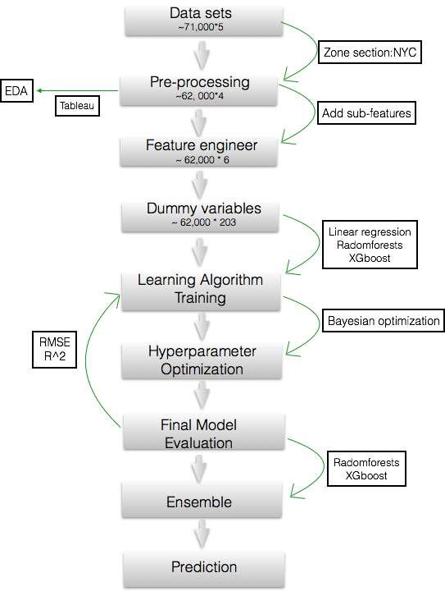
Modeling Workflow

Slide 7
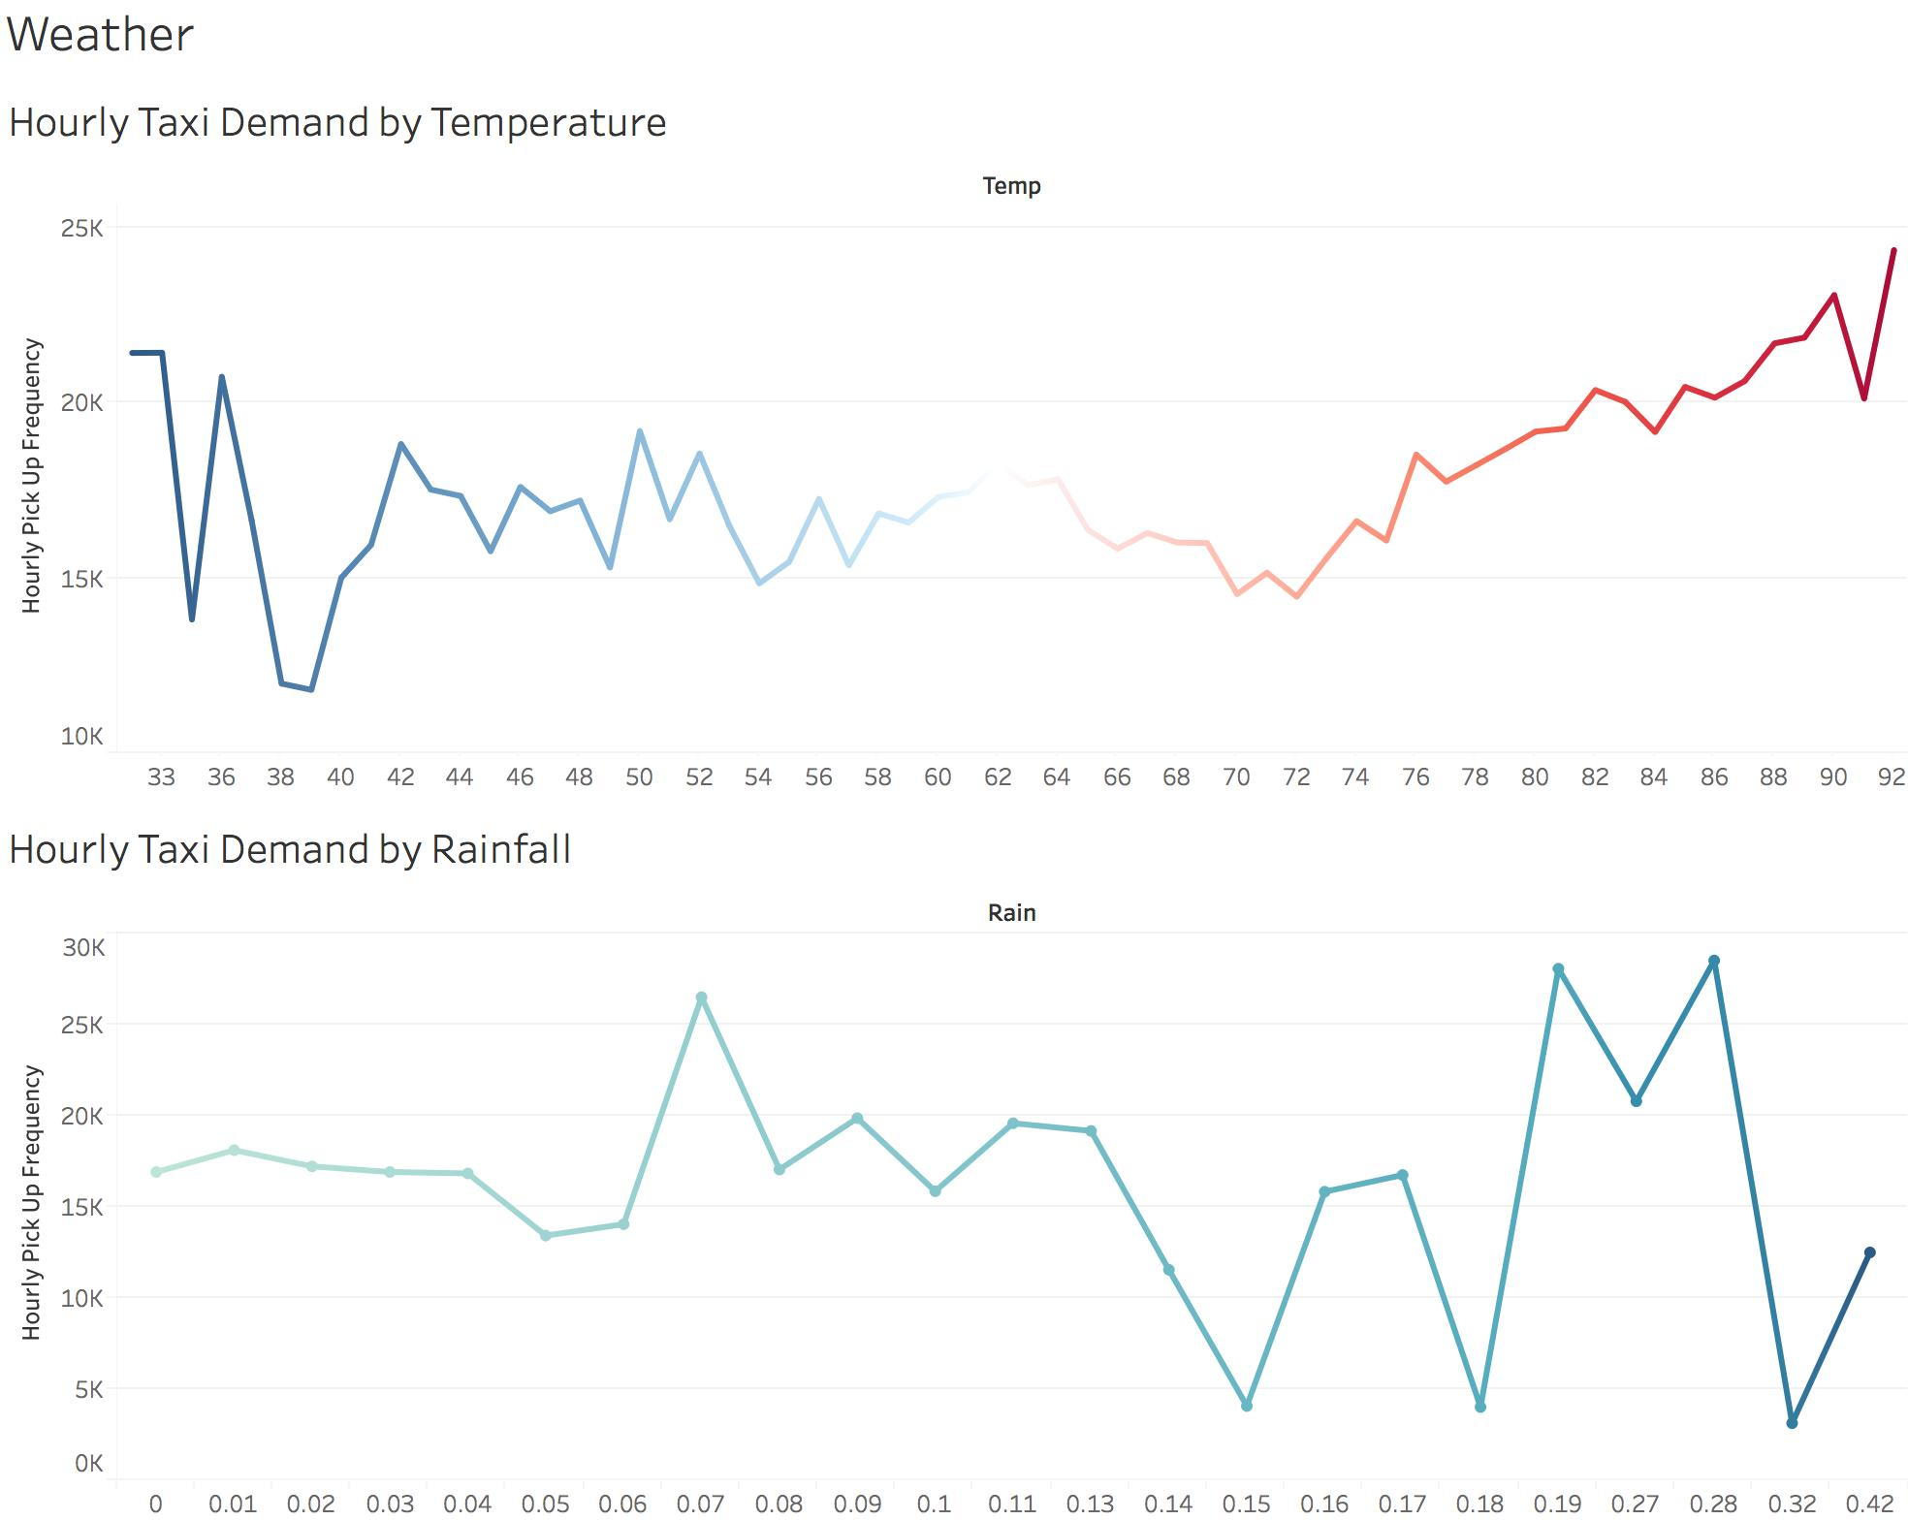
EDA (Tableau)
Notes:
From above graph, the overall trend of hourly pick up frequency is getting larger from middle 62ºF to the right and left sides. Meanwhile, the fluctuation is getting bigger from middle to the two directions as the temperature becoming colder or hotter. Thus, the temperature has great influence on the taxi demand, which is also very intuitive that people require more taxies to go out when the temperature are cold, for example below 36ºF. While, people favor to take taxi when the temperature is hot. luence on the taxi demand, which is also very intuitive that people require more taxies to go out when the temperature are cold, for example below 36ºF.

Slide 8
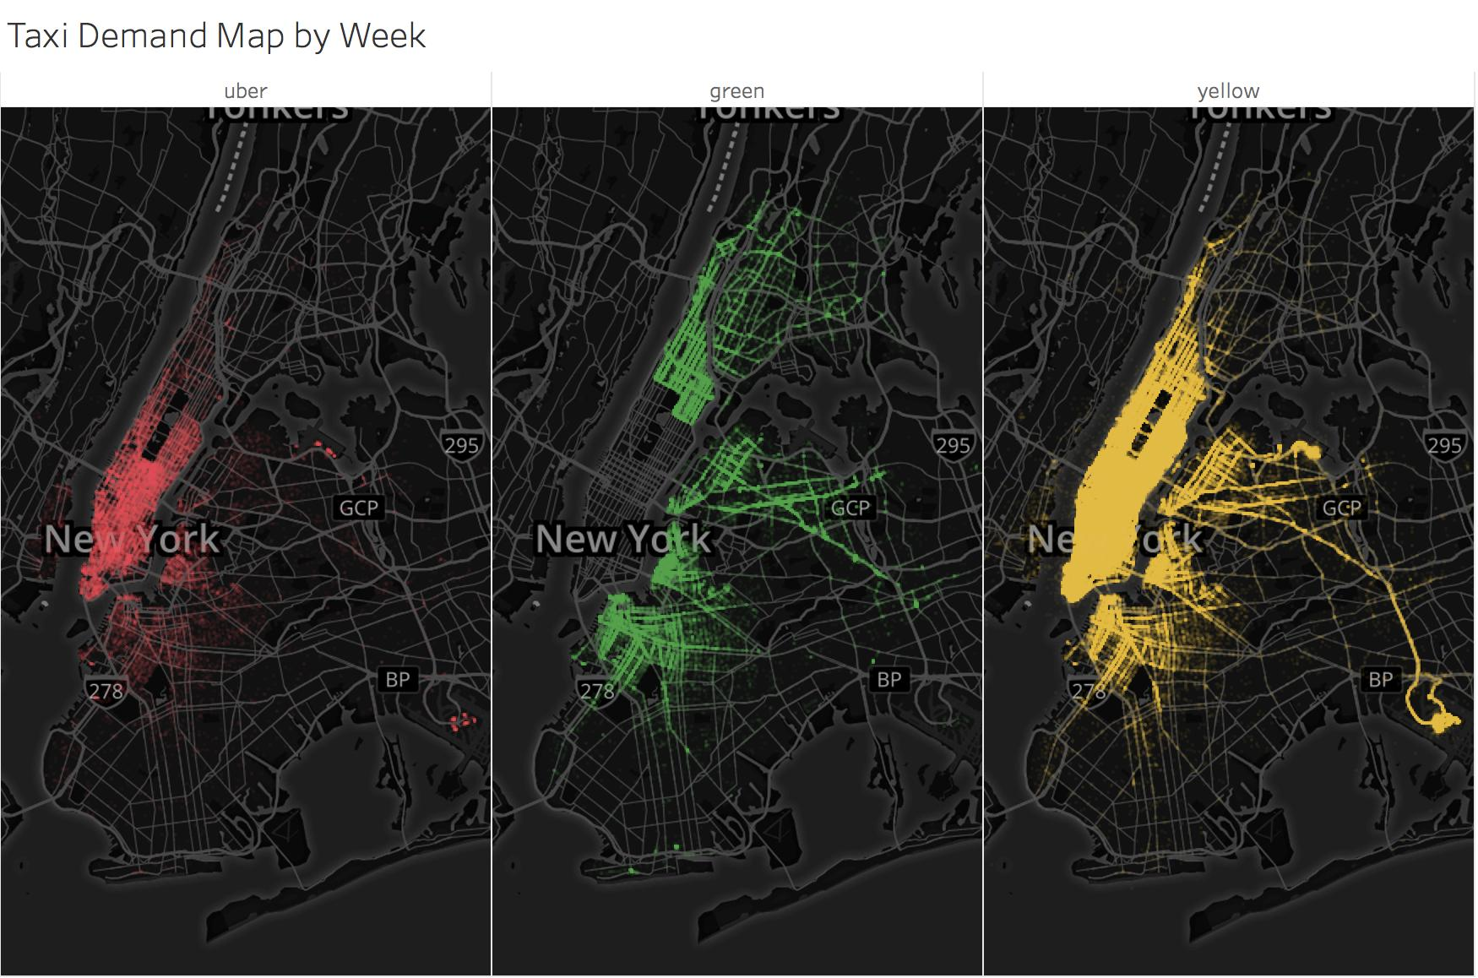
EDA (Tableau)

Slide 9
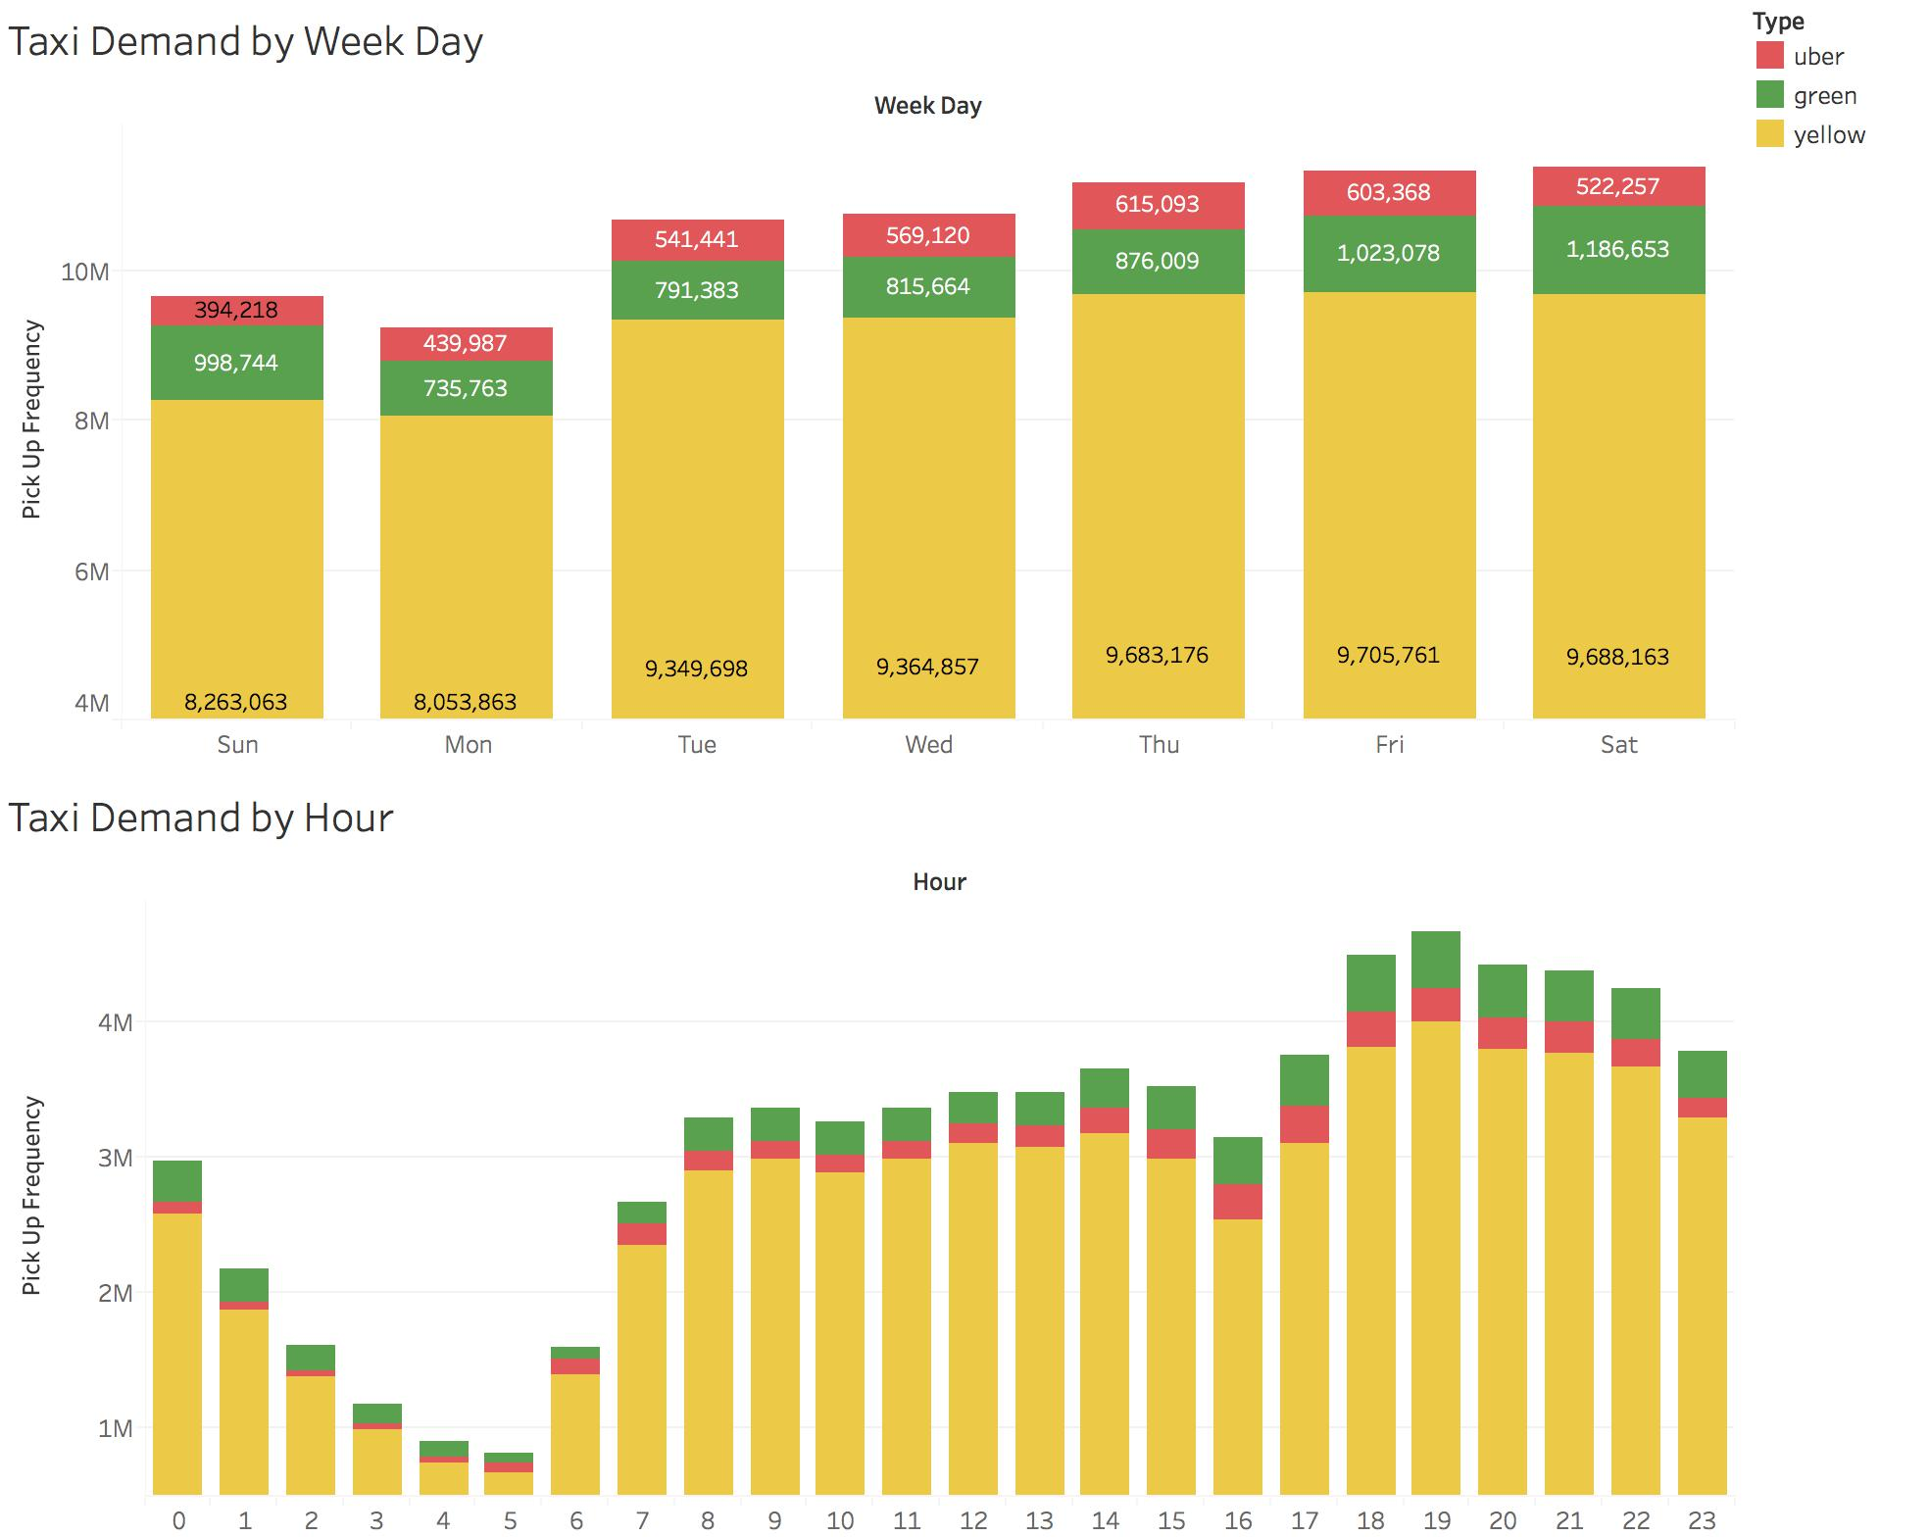
EDA (Tableau)

Slide 10
MLR and Ridge Regression
Multiple-linear Regression
Train
R^2: 0.75
RMSE: 127.35
Test
R^2: 0.76
RMSE: 125.56
Ridge Regression
Bayesian Optimization
12 iteration to find best alpha
Train
R^2: 0.75
RMSE: 127.34
Test
R^2: 0.75
RMSE: 125.56

Slide 11
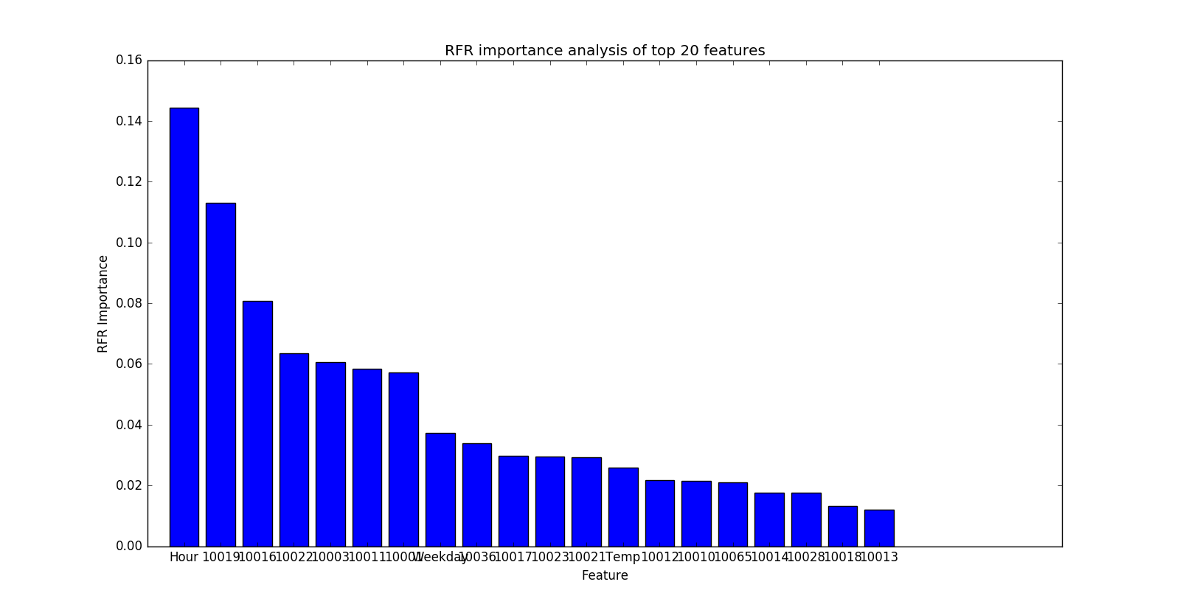
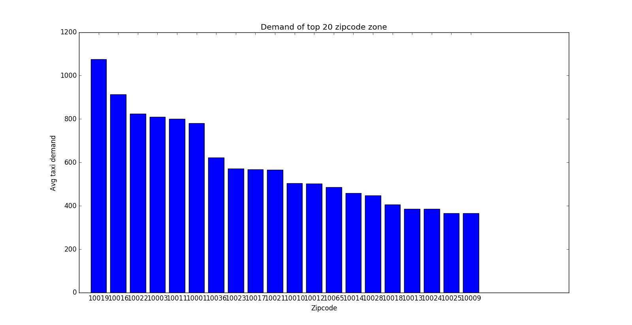
Random Forest
RandomForests
Bayesian Optimization
2 iteration to find best max_features and n_estimators
Test
R^2: 0.97
RMSE: 40.60
Train
R^2: 0.99
RMSE: 16.05

Slide 12
XGBOOST
Parameters | Range | Best (lowest MSE)
Max_depth | 3 ~ 14 | 14
Learning_rate | 0.01 ~ 0.2 | 0.1186
N_estimators | 50, 1000 | 463
gamma | 0.01 ~ 1.0 | 1.0
Min_child_weight | 1 ~ 10 | 6.1929
Subsample | 0.5 ~ 1 | 0.9675
Colsample_bytree | 0.5 ~ 1 | 0.8544
XGBOOST
Bayesian Optimization
30 iteration to find best parameters combination
Test
R^2: 0.98
RMSE: 35.01
Train
R^2: 0.99
RMSE: 21.85

Slide 13
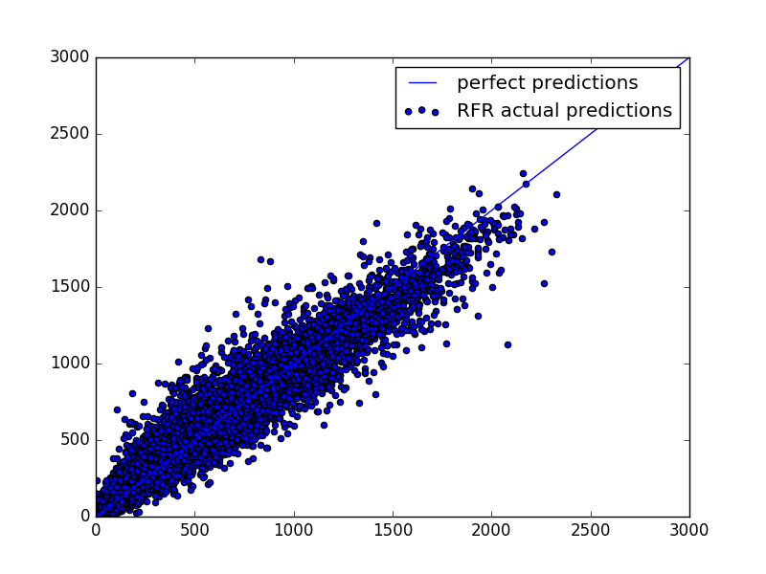
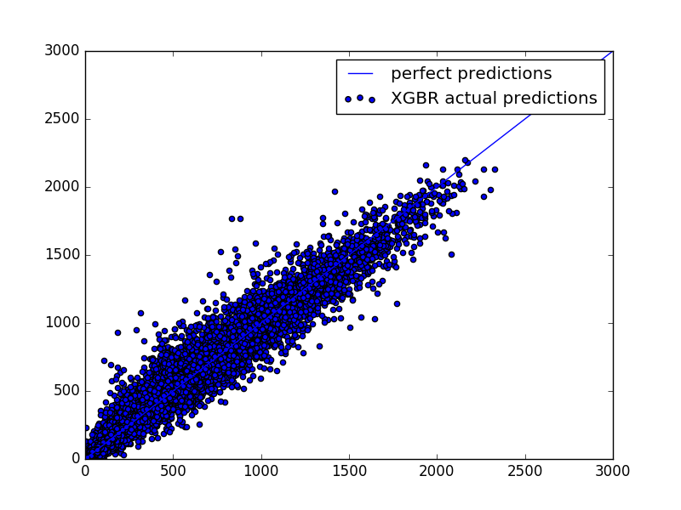

Ensemble
RandomForests Regression
Xgboost Regression
Ensemble (Linear Regression)
Predicted number of pickups
True number of pickups
Model | R^2 | RMSE
MLR | 0.76 | 125.56
Ridge | 0.75 | 125.56
RFR | 0.97 | 40.06
XGBR | 0.98 | 35.01
Ensemble | 0.97 | 42.95
Predicted number of pickups
Predicted number of pickups
True number of pickups
True number of pickups

Slide 14
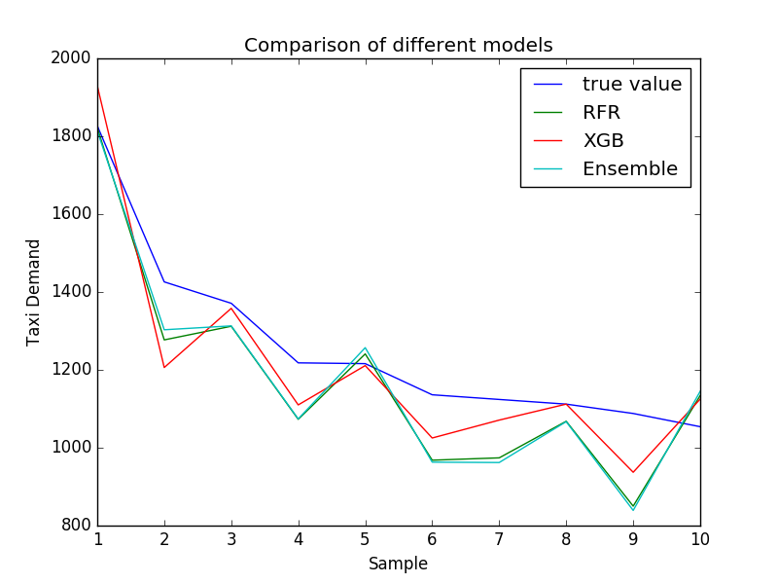
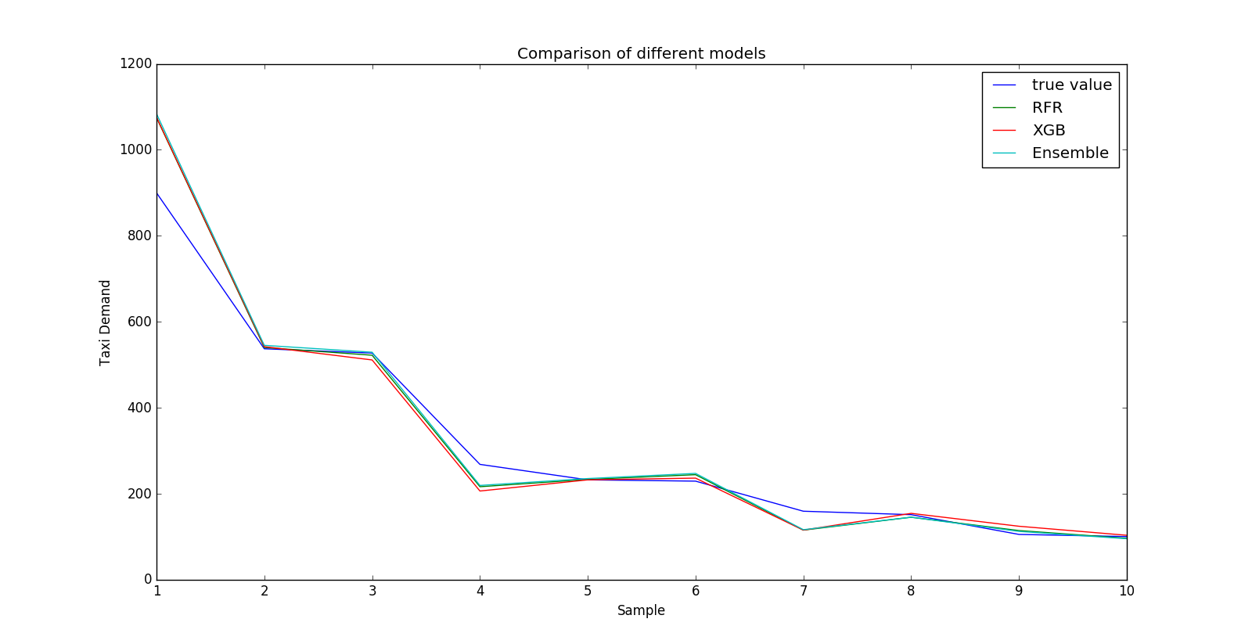
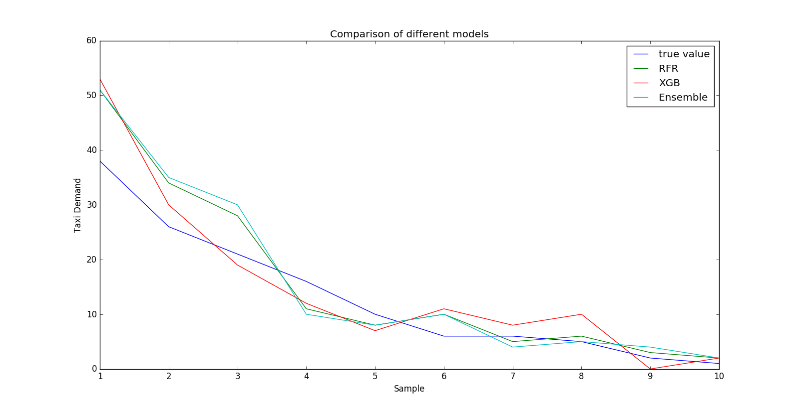
Further Comparison of Models
Subset | Demand | Size | RFR RMSE | XGBR RMSE | Ensemble RMSE
Subset 1 | >=1000 | 2479 | 150 | 123 | 156
Subset 2 | 100 ~ 999 | 24759 | 75 | 66 | 80
Subset 3 | <100 | 95472 | 8.7 | 7.2 | 9.5

Slide 15
Prediction for the Coming Week
RandomForest
XGBOOST
Ensemble

Slide 16
Future Work

Slide 17

Thanks for your time
QUESTIONS?

